Slide 1
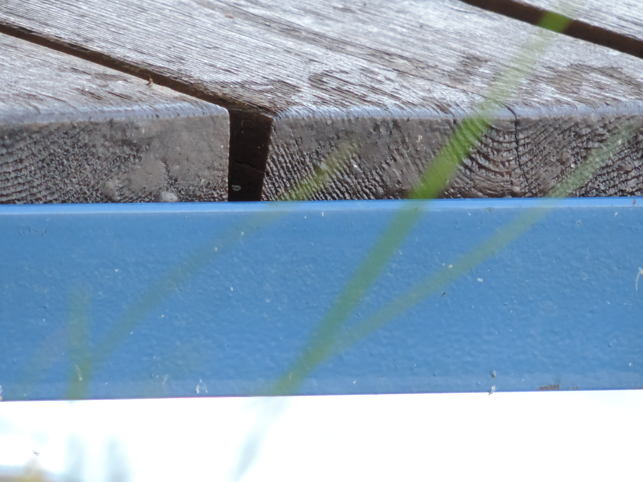
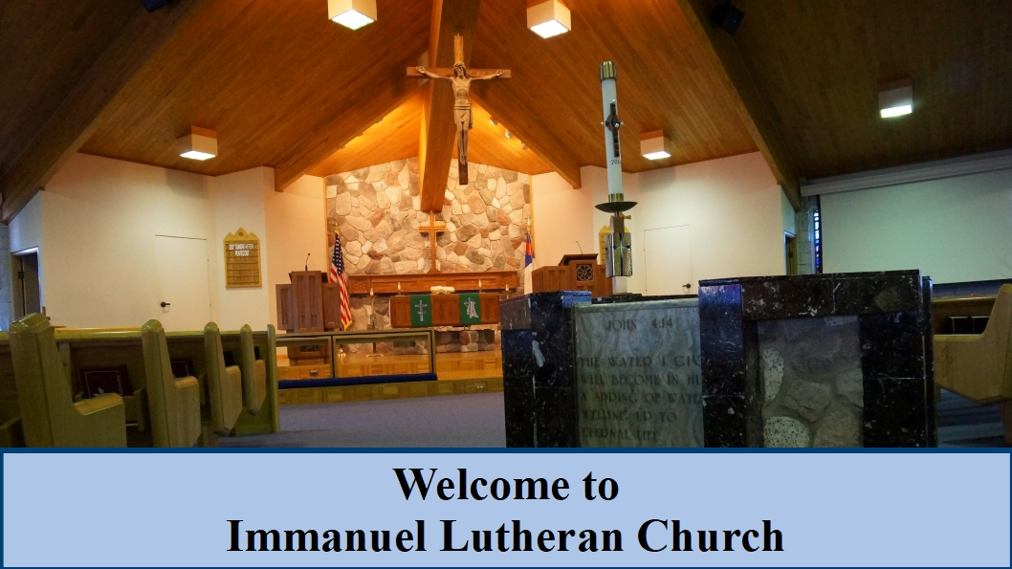
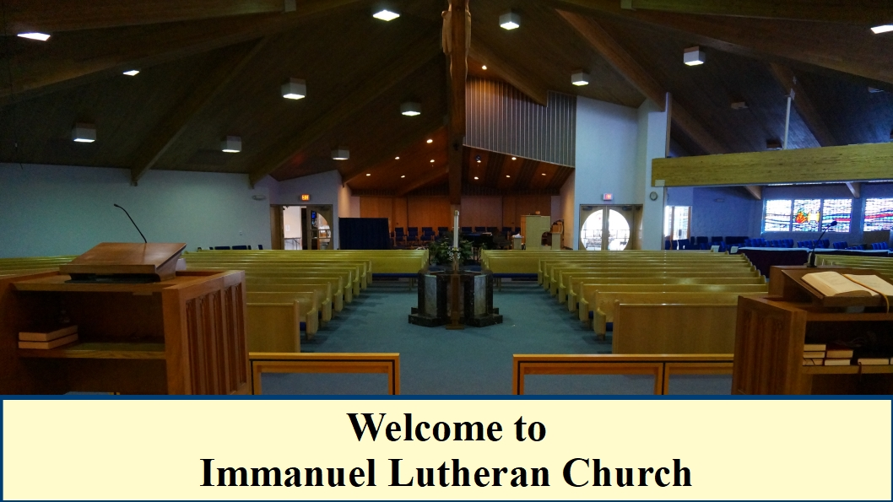
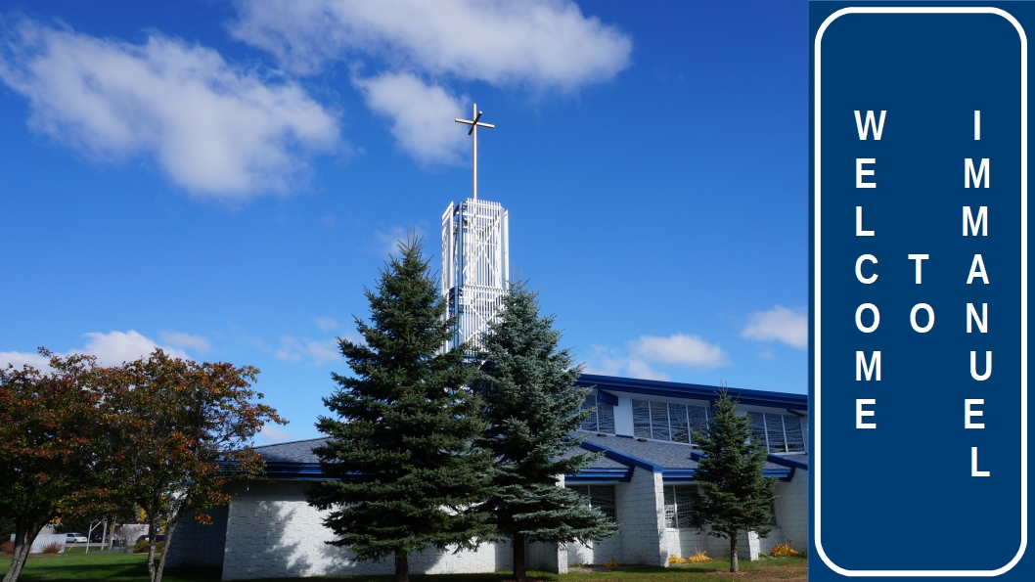
Welcome to
Immanuel Lutheran Church!
We are happy to have you join us
in worship today.

Slide 2



Slide 3
COMMUNION ACCESSIBILITY
We try to accommodate
everyone who worships with us at Immanuel.
If for any reason
you are unable to commune at the altar,
please inform an usher,
and we will bring communion to you.

Slide 4



GIVE A SMILE
SHAKE A HAND

Slide 5
B
I
B
L
E
S
T
U
D
Y
“FOLLOW”
Jesus only issues an invitation to relationship, that begins with a simple request: “Follow Me”.
Pastor Al Kersten leads this DVD/ workbook based study by Andy Stanley, as we journey follow Jesus through the Gospels.
The study begins at 9:15 a.m.
Check the bulletin for the location.

Slide 6
B
I
B
L
E
S
T
U
D
Y
“ROOTED IN THE PREEMINENT CHRIST”
A new study begins
Sunday, March 3 at 9:15 a.m.
This discussion based study will go through
St. Paul’s letter to the Colossians!
The study is led by Pastor Erickson.
See the bulletin for details.

Slide 7
B
I
B
L
E
S
T
U
D
Y
“EARLY BIRD BIBLE STUDY”
This study meets Monday mornings
at 7:00 A.M. in the lighthouse room
of the Thunder Bay River Restaurant.
Pastor Erickson leads
this current study
is in the book of 1 Kings.

Slide 8
B
I
B
L
E
S
T
U
D
Y
“PEW SISTERS”
Join Amy Schultz, Monday evenings
at 6:00 P.M. in the church library.
This study tells what God has done,
and is still doing in the lives of women
in the church today.

Slide 9
B
I
B
L
E
S
T
U
D
Y
“JOURNEY THROUGH GENESIS”
This study meets in the adult ed room Thursday mornings at 10:00 A.M.
Join Pastor Schultz
for this continuing study
in the book of Genesis.

Slide 10
B
I
B
L
E
S
T
U
D
Y
“VILLAGE PEOPLE BIBLE STUDY”
This study entitled,
“REVELATION BLITZ”,
meets Thursdays at 2:00 P.M.
in the adult education room.
Pastor Erickson is the class leader.

Slide 11

Do you need the PRAYER CHAIN?
Contact Kristine Ball
at 356-9316

Slide 12

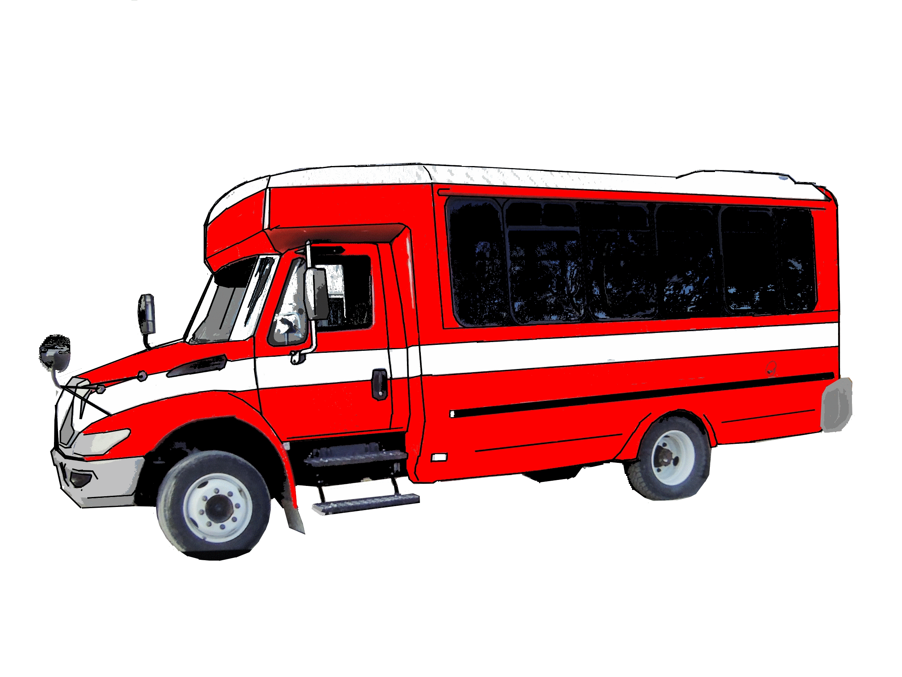
DO YOU NEED A RIDE TO CHURCH?
The Board of Social Ministry
provides free rides on Dial-a-Ride
to and from our 10:30 Sunday services.
Contact Dave Meyer
for information at 354-5864.

Slide 13
LUTHERAN WOMEN IN MISSION
All women are invited to the evening LWML meeting on Monday, January 14 at 6:30 P.M. in the church fellowship room.
The program will be Dominican Republic missionaries Christel & James Neuendorf.

Slide 14

Meets Thursday
at 6:00 P.M.
in the library/lounge
area of the church.
CLOSE THE BACK DOOR

Slide 15

Visitation Evangelism meets
Thursday at 9:30 A.M.
in Pastor Erickson’s office.

Slide 16
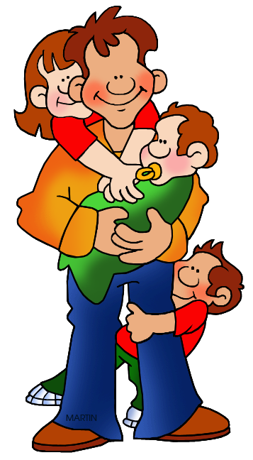


THIS FRIDAY at 6:30 P.M.
(fun, popcorn, desserts, & beverages)
Sign-up on the table in the church narthex!

Slide 17
DO YOU ENJOY SINGING?
Join the Adult Choir!
They meet Thursdays
at 6:30 PM.

Slide 18


YOUTH GROUP
THURSDAYS at 6:30 p.m.
for Grades 7-12 and College-age

Slide 19

Valentine
COUPLES’ NIGHT OUT
Friday, February 15, 2019
Join us for an evening of food, fun, and friends. A lite dinner, a game show (based on the Newly Wed Game Show), and a lot of fun. Sign-up in the narthex due to limited seating.

